Slide 1


Team 50: Remote Biometric System
Bi-Weekly Update 1 Simon Becker
Andrew-Joseph Nicolas
Lance Pagaduan
Harin Sankar Sponsor: Dr. Steven Wright TA: Hailey Ward
Notes:
Michelle

Slide 2
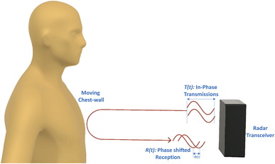
Contactless Cardiac Gating
Extensive and uncomfortable prep can be necessary
MRI Patient throughput can be improved
32% of patients think they wait too long for MRIs¹
Vasireddy, Rakesh & Roth, Corinne & Mathis, Johannes & Goette, Josef & Jacomet, Marcel & Vogt, Andreas. (2018). K-band Doppler radar for contact-less overnight sleep marker assessment: a pilot validation study. Journal of Clinical Monitoring and Computing. 32. 10.1007/s10877-017-0060-9.
Dostál, M., Jurasová, K., Keřkovský, M. et al. What factors affect a patient’s subjective perception of MRI examination. Sci Rep 14, 22731 (2024). https://doi.org/10.1038/s41598-024-74231-9
Notes:
Kyle

Slide 3
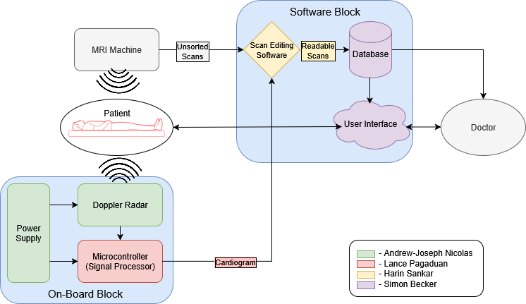
Contactless Cardiac Gating
Notes:
Eric

Slide 4
Major Project Changes for 404
The radar itself will need to be configured. This will be done by Harin and Simon.
PCB and front-end hardware updated.
Notes:
Eric

Slide 5

Project Timeline
Notes:
Eric

Slide 6
PCB
Andrew
Accomplishments since 403 15 hrs of effort | Ongoing progress/problems and plans until the next presentation
Board redesign fully completed. New hardware added to front-end. Validation of integration between all potential hardware. | Validate layout and order board.

Slide 7
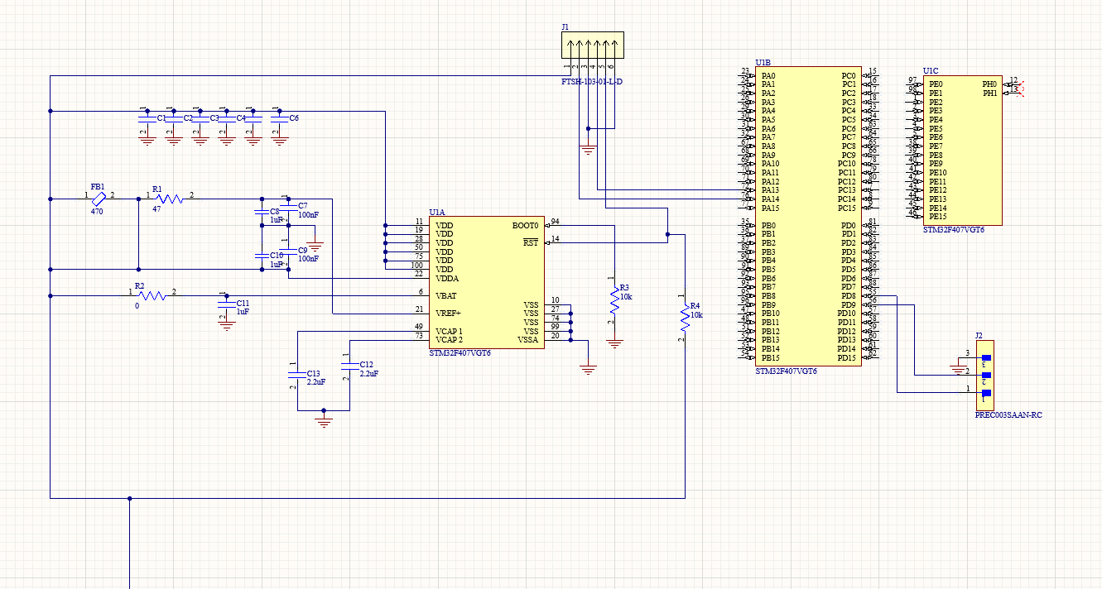
PCB
Andrew
Redesign ready for new hardware & MCU I/O.

Slide 8
MCU
Lance Pagaduan
Accomplishments since 403 12 hrs of effort | Ongoing progress/problems and plans until the next presentation
Collaborated with the PCB/Radar subsystem to verify all MCU parts are present | Begin integration of MCU onto the PCB Replace code block that houses sample data with live radar input

Slide 9
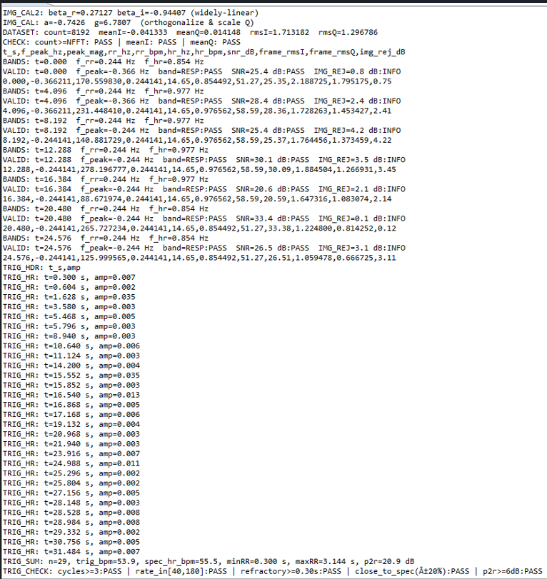
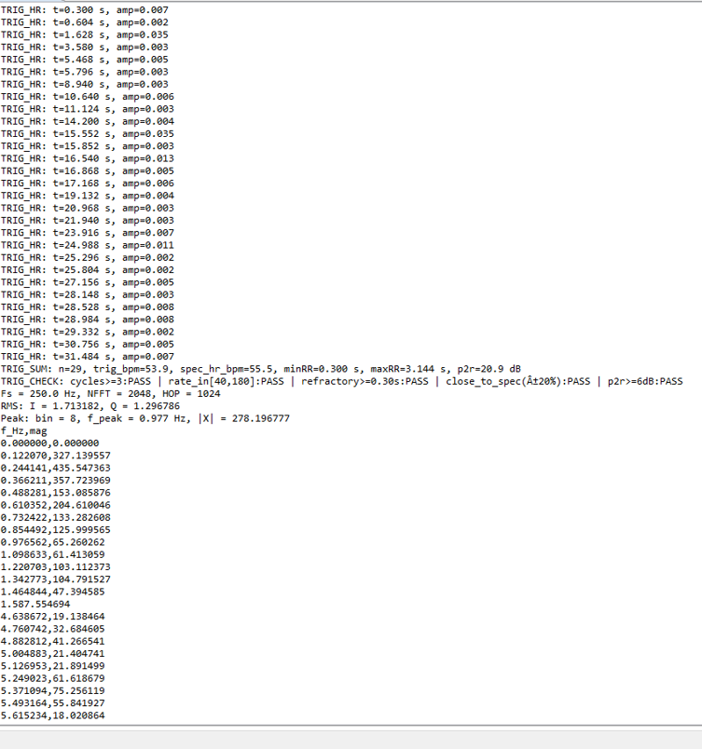
MCU
Lance Pagaduan

Slide 10
Scan Filter
Harin Sankar
Accomplishments since 403 9 hrs of effort | Ongoing progress/problems and plans until the next presentation
Fixed cardiac phase binning edge cases, correcting misassigned frames near bin boundaries. Tested arrhythmic cardiac cases, confirming binning and synchronization under irregular heartbeats. | Confirm MRI vendor system and sequence for testing Determine echo data format (vendor dependent) for subsystem input handling

Slide 11
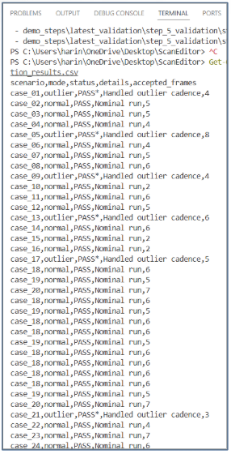
Scan Filter
Harin Sankar
Arrhythmic Test Cases

Slide 12
User Interface
Simon Becker
Accomplishments since 403 5 hrs of effort | Ongoing progress/problems and plans until the next presentation
Determined admin role restrictions | Apply admin role restrictions Integrate stored metadata into DICOM file format architecture

Slide 13
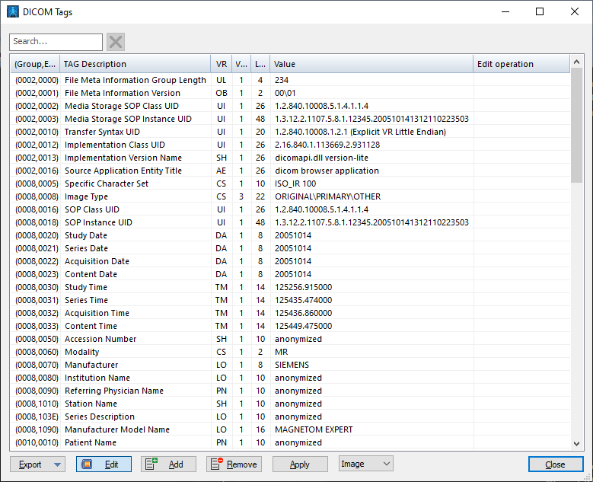
User Interface
Simon Becker

Slide 14
Parts Ordering Status
Part | Status
Radar: IWR6843 | In Locker
Data Capture Board: DCA1000EVM | In Locker
PCB | Pending Order
MCU: STM32F407VGT6 | Pending PCB
Notes:
Michelle

Slide 15
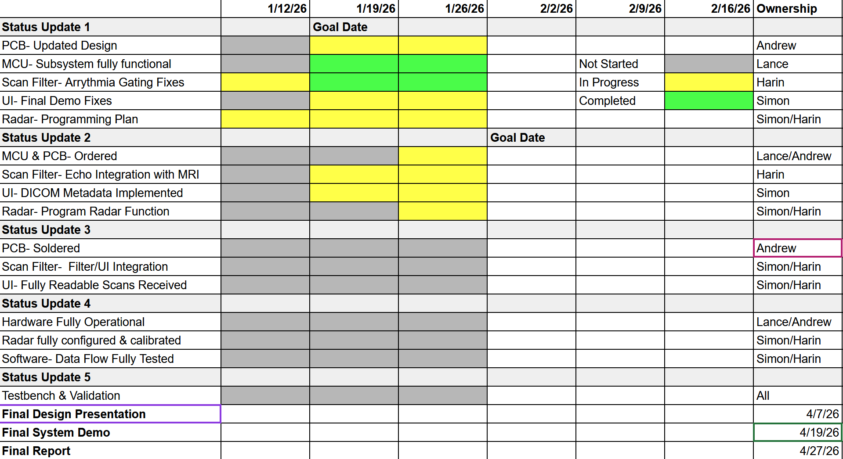
Execution & Plan
Notes:
Michelle

Slide 16
Thank you!

